Slide 1
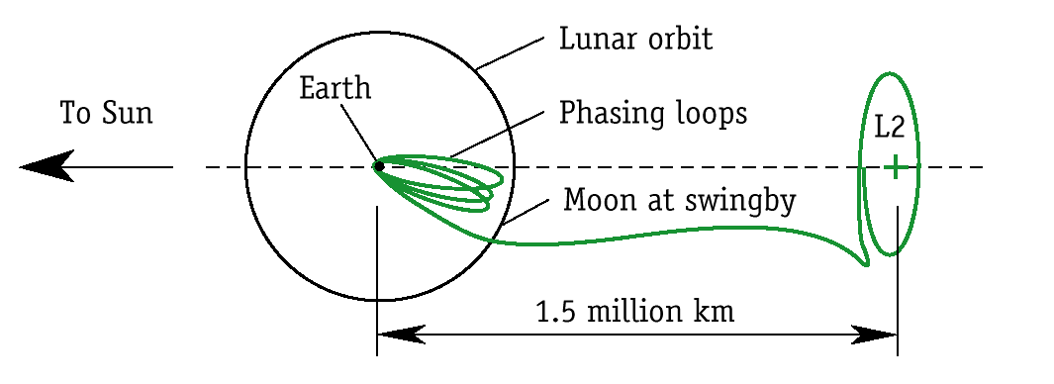
MAP Mission Design

Slide 2
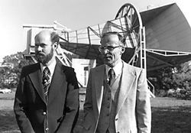
The Discovery of the Cosmic Microwave Background (CMB)
Found by Penzias and Wilson in 1963
Interpreted by Peebles to be the redshifted remnant radiation from the big-bang
Penzias and Wilson

Slide 3
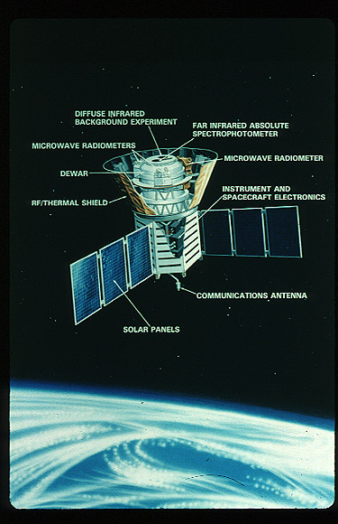
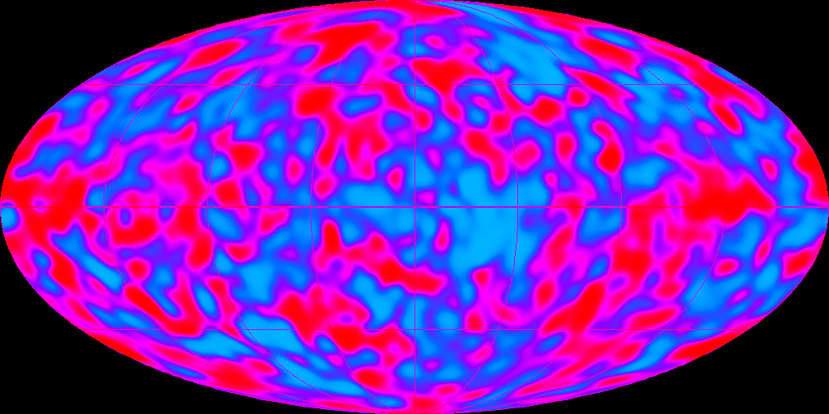
Is it Smooth?
COBE Launched in Oct. 1989
Found fluctuations in the CMB radiation
Quantum field theory coupling to General Relativity

Slide 4
MAP (Microwave Anisotropy Probe)
From the MAP home page:
The goal of MAP is to address three of the most fundamental questions in cosmology:
  1) What are the values of the cosmological parameters of the Big Bang theory?
  2) How did structures of galaxies form in the universe? and
  3) When did the first structures of galaxies form?
To answer these questions MAP will produce an accurate full-sky map of the cosmic microwave background temperature fluctuations with high sensitivity and angular resolution.

Slide 5
The MAP Mission
Launch on a Delta 7425-10 from Cape Canaveral
  3-stage rocket with 4 strap-on solids
    stage 1: solid motor
    stage 2: liquid motor
    stage 3: Star 48 solid motor
  10 foot fairing
Current launch date 11/07/2000
Lunar assisted trajectory out to L2
3-5 “phasing loops” before lunar encounter
Cruise phase to L2 “insertion”
Maintain lissajous orbit about L2 for 2+ years

Slide 6
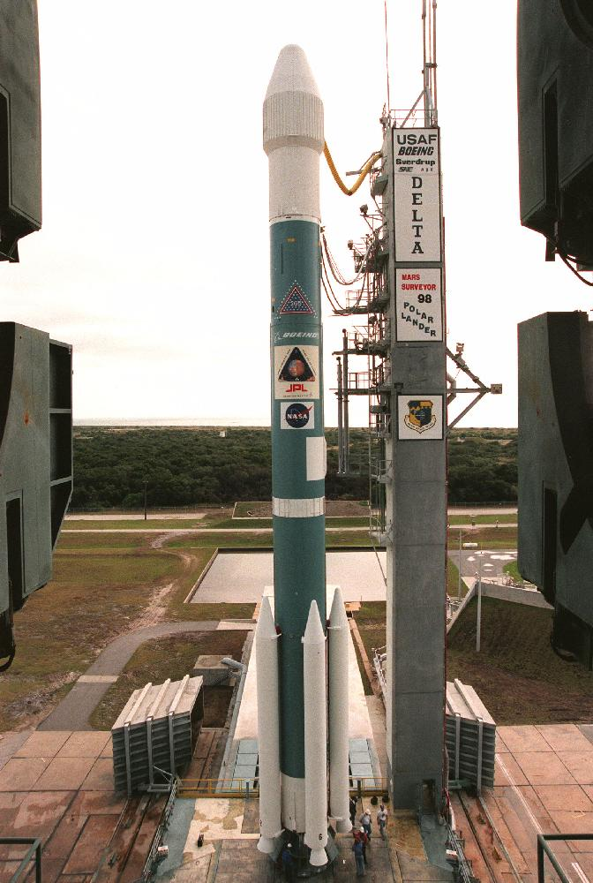
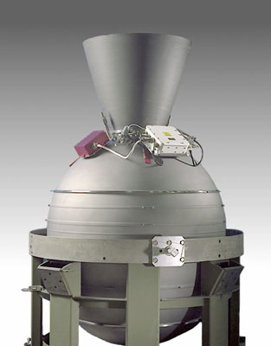
Delta 7425
Star 48B Solid Motor

Slide 7
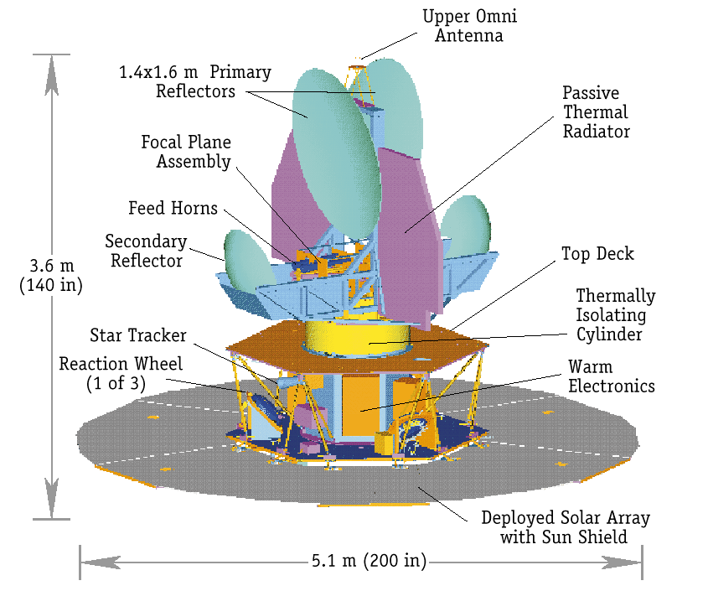
The MAP Spacecraft

Slide 8
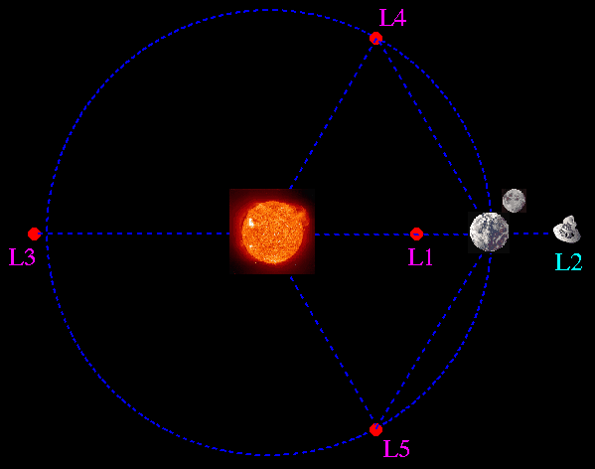
The Lagrange Points (earth-sun system)

Slide 9
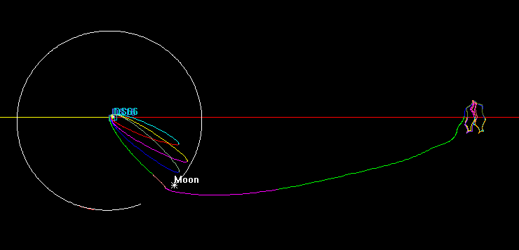
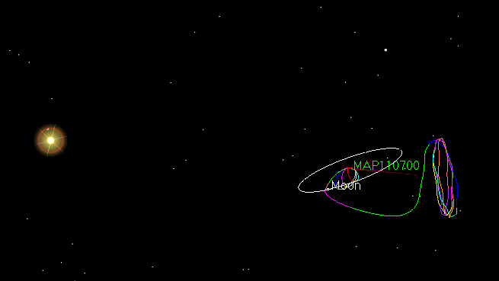
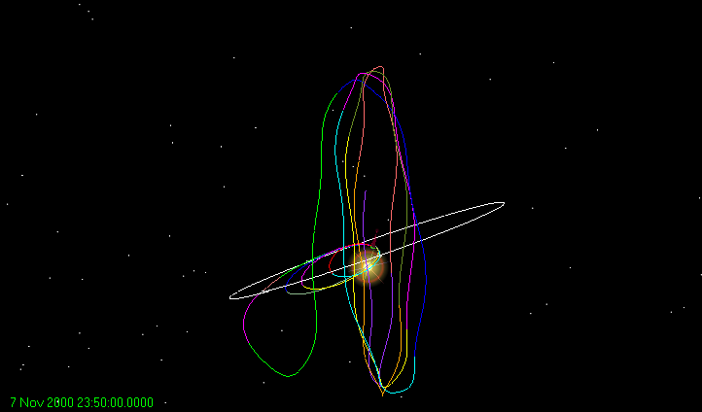
Sample MAP Trajectory
Rotating Libration Point (RLP)coordinate system: Sun-earth-moon system

Slide 10
Mission Constraints
2 year minimum life at L2
Avoid sun shadows
Minimize lunar shadows in phasing loops
Minimum 500 km perigee altitude in phasing loops
Minimize the final pre-lunar encounter maneuver (P3)
Minimize lunar shadows in lissajous orbit
Size in lissajous orbit
  maximum s/c-Earth-L2 angle 10.5 degrees
  minimum s/c-Earth-L2 angle 0.5 degrees

Slide 11
Basic Design: The Lunar Swingby
With 3 or 5 phasing loops, utilize maneuvers to set up optimum lunar encounter
Lunar encounter known as B-plane targeting
In 3-loop case use P1 and P3 to target the b-plane parameters
Launch vehicle dispersions affect design strategy
  TTI dispersion ±11.6 m/s (mission specific)
Might require an A1 maneuver to avoid earth impact (!!!!) or P2 maneuver to minimize P3

Slide 12
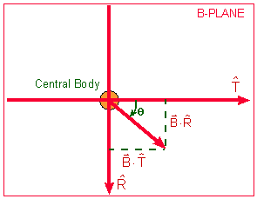
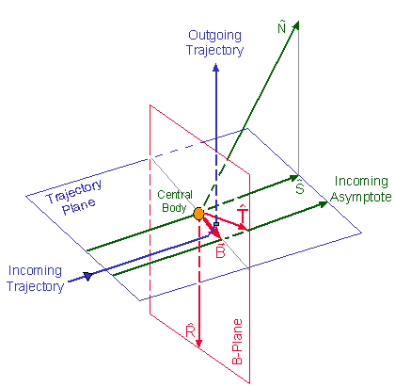





Using The B-Plane
The b-plane is perpendicular to the trajectory plane
The intersection of the two planes forms the B vector,
To construct the b-plane
  use incoming asymptote,
  use either the body’s polar vector or it’s orbit normal,
  cross S and N to obtain
  cross S and T to obtain
Targets for mission design are magnitude of and

Slide 13
Basic Design: Post-Lunar Encounter
Mid-course maneuver after lunar encounter
  to correct lunar encounter perturbations
  to set-up shadow avoidance in the halo orbit
The lissajous orbit
  2 year nominal life
    1 orbit is ~180 days
    4 revolutions = 2 years
  stationkeeping maneuvers using max 4 per year (total 4 m/s)
  shadow avoidance maneuvers

Slide 14
Trajectory Design
Begin with simple Delta launch model, coast to TTI
Lunar encounter near sun-earth-moon angle ≅ 125 deg
Target on the center of the moon using P1 and P3
After initial results refine to b-plane targets at periselene
Refine b-plane targets to achieve RLP x-z cross near L2
Use P3 or MCCM to achieve correct velocity at first cross in order to have a second cross and third cross
Switch to stationkeeping maneuvers to balance lissajous for 4-9th cross
After trajectory is designed, verify all constraints are met to satisfaction
Design trajectories for launch vehicle dispersion cases
  plus 3 sigma, minus 3 sigma, re-verify all constraints and possibly re-design
…done...with one day of launch block!!!

Slide 15
Design Issues
Lunar shadows in the lissajous orbit
  characterizing shadow occurrences
  avoiding vs. maneuvering around
Targeting “opening” lissajous orbits
  currently have little control over opening or closing designs
Stationkeeping location and size
  couple with shadow maneuvers or momentum dumps?
Determine daily launch window duration
  10-20 minutes desired
Extend monthly launch window
  currently ~10 days
  non-consecutive, break between 3 and 5 loop cases

Slide 16
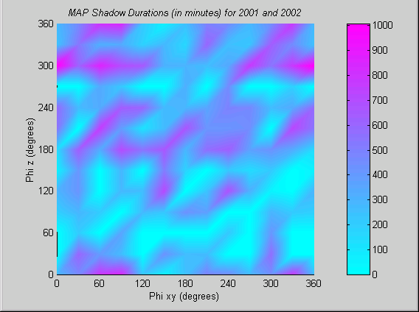
Shadow Durations Over the Family of Lissajous’s

Slide 17
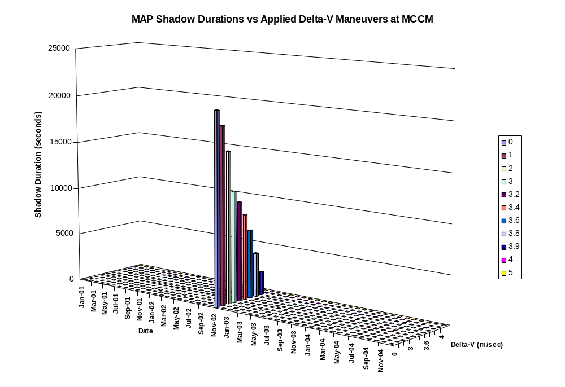
Lunar Shadow Avoidance Maneuvers

Slide 18
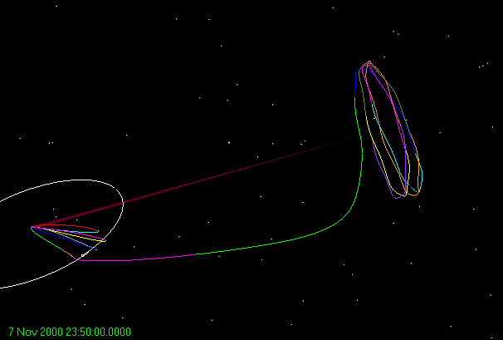
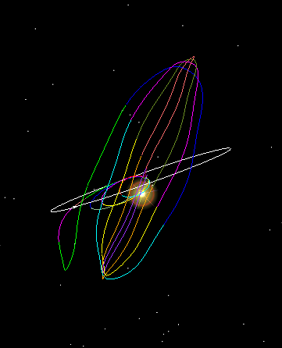
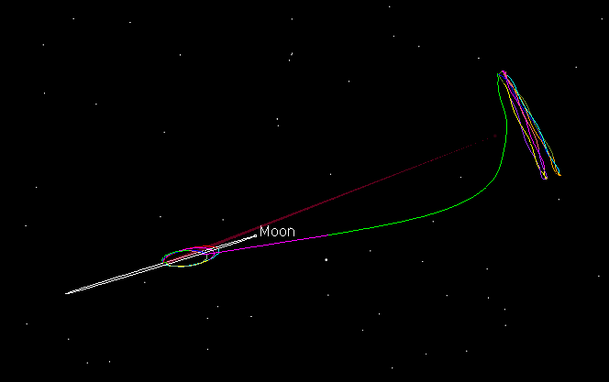
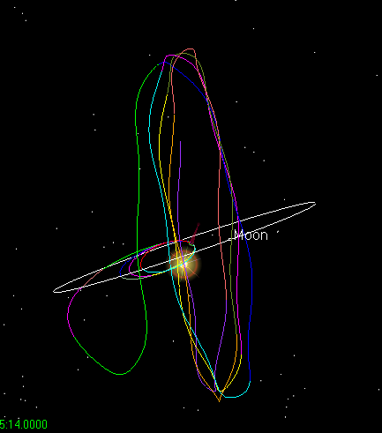
Opening and Closing Lissajous
⇐ “Closing” Lissajous
“Stable” Lissajous ⇒

Slide 19
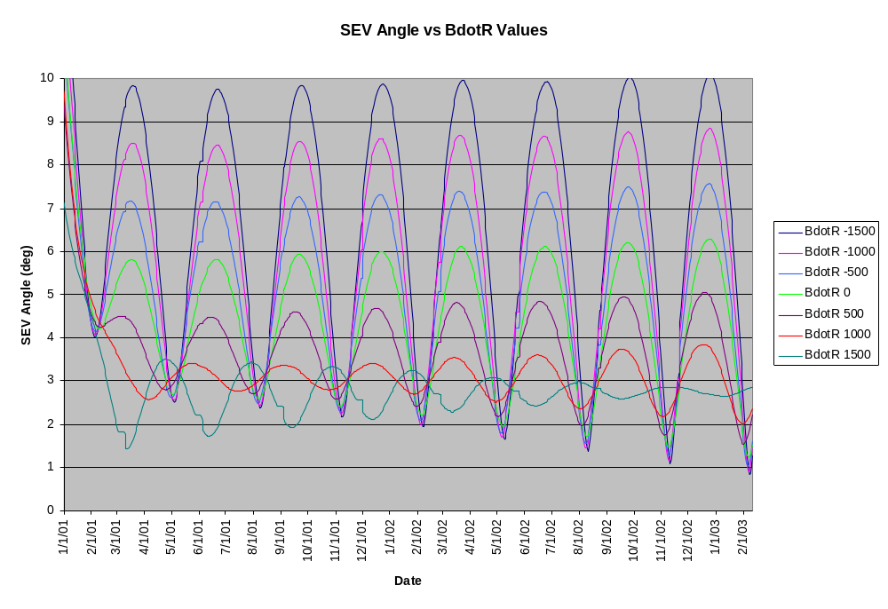
Opening the Lissajous - Solutions are Possible

